Slide 1
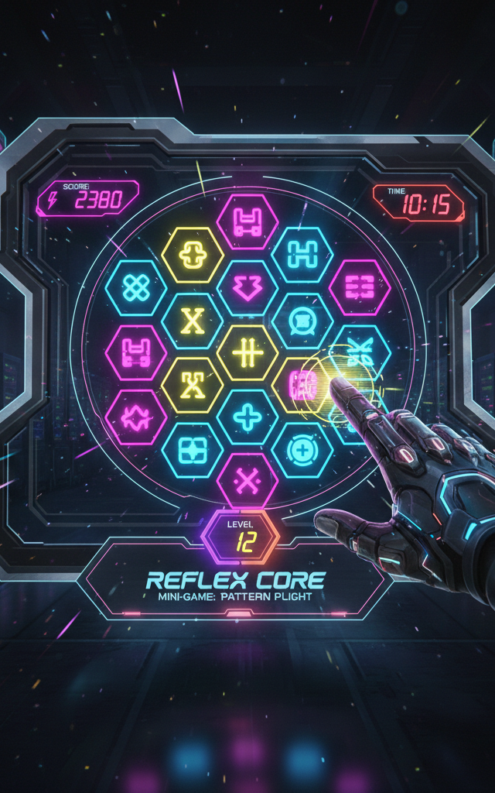
Reflex Core
Genre: Competitive / Skill Trainer | Platform: Mobile, PC, Web
Rating: Everyone (E) | Targeting: Professional & Aspiring Esport Athletes
Overview
Reflex Core is a high-performance cognitive trainer designed to bridge the gap between "logging in" and "winning." It serves as a specialized pre-match ritual, priming the player's nervous system for peak tournament readiness. In a landscape where milliseconds determine victory, Reflex Core ensures your brain is as sharp as your aim.
Core Gameplay Modules
Touch the Light: A high-speed reactivity test to sharpen spatial awareness and peripheral vision.
Falling Objects: A precision task requiring players to filter correct items from distractions under pressure.
Fake & Real Signal: A cognitive discrimination challenge to improve decision-making speed and trigger discipline.

